Slide 1
CSS3 Cascading Style Sheets

Slide 2
Browser Default Styling
The same html file may look different when viewed on different browsers.
Some tags are supported, some aren’t
Browsers may have different default styles
In general, default looks are plain.

Slide 3

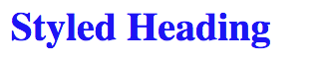
Adding Style
As styling tags were phased out of html, styling was done with style attribute
Violated separation of content/style

Slide 4
Cascading Style Sheet
CSS defined generic rules that can apply to multiple elements
selector {
property: value;
}
h1 {
color: blue;
}

Slide 5
Rule Syntax
Brackets and semicolons are very important
This is where a good editor can make a BIG difference
h1 {
color: blue;
/* This is a CSS comment */
}

Slide 6

Multiple Properties
h1 {
color: blue;
background-color: yellow;
}

Slide 7
Internal Style Sheet
<head>
<title>Home</title>
<style>
h1 { color: blue;}
</style>
</head>
Styling is defined within <head>
Rules are defined within <style>
Styles are applied to all elements in that file
Don’t forget to close the style tag!!

Slide 8
External Style Sheet
Rules are in an external file (no style tag)
A link to the style sheet is put in the head section of the html file.
<link rel="stylesheet" href="css/style.css">
Styles are applied to all elements in all files that link to the style sheet

Slide 9
The “Cascading” part of CSS
Browser default
External (in a separate file)
Internal style (in the head section)
Inline style (inside an HTML element)

Slide 10
IMPORTANT
You should primarily use an external style sheet in this class – rare exceptions may occur
You should not create a separate style sheet for each page. Typically, a rule should only appear once.

Slide 11
Color Conventions
Color names
blue, red, yellow, etc.
Hexadecimal
#0000FF, #FF0000, #FFFF00
rgb
(0, 0, 1), (1, 0, 0), (1, 1, 0)
rgba
(0, 0, 1, .5)
blue
#0000FF
#FF0000
#FFFF00
rgb(0,0,1)
rgba(0, 0, 1, .5)

Slide 12
Accessibility
Appropriate use of color is critical to web accessibility
Many more people are visually impaired or color blind than are legally blind

Slide 13
What is color contrast?
Your judgement is not sufficient so use validators that quantify the contrast between text and its background
WCAG AA requires "at least 4.5:1" contrast
If you LOVE your color scheme, make the font bigger.

Slide 14
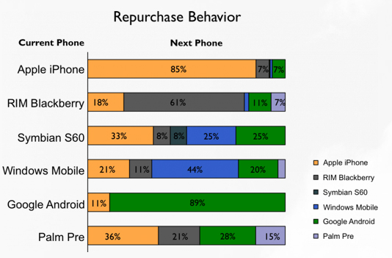
Don’t use color alone to convey meaning

Slide 15
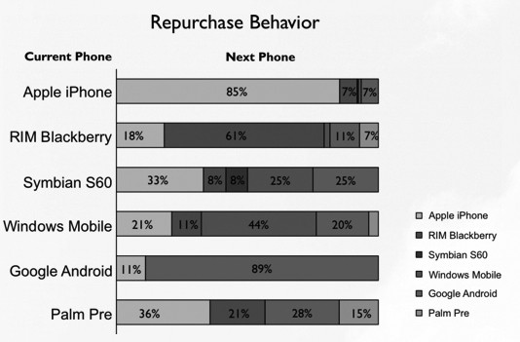
Test in gray scale …

Slide 16
Styling Your Text
font (family, style, variant, size)
color and background
alignment
line-height
more...

Slide 17
font-family
Font families are styles of text
Examples:
Helvetica, Courier, “Courier New”, “Comic Sans MS”, cursive, Verdana

Slide 18
Defining Multiple font-family values
Not all font-families are supported by all of the operating systems, so you can provide alternatives.
h1 {
font-family: Courier, Impact, Arial;
}

Slide 19
Google Fonts
<link href='https://fonts.googleapis.com/css?family=Anton’ rel='stylesheet’>
<style>
body {
font-family: 'Anton’;
}
<style>
https://www.w3schools.com/howto/howto_google_fonts.asp

Slide 20
Rule precedence
h1 { color: blue;
font-family: Arial;}
…..
h1 { font-family: Times; }
h1 { color: blue;
font-family: Arial !important;}
…..
h1 { font-family: Times; }
What if a selector appears more than once in a file?
What if one selector is defined in two external files?
It is possible to override default precedence.

Slide 21
Review
Why do we want/need to separate content from formatting?
How does this also tie in to external/internal style sheets?
Understand that this is very powerful. See http://www.csszengarden.com/

Slide 22
Designing for Accessibility
POUR Principle
Perceivable
Operable
Understandable
Robust

Slide 23
Perceivable
Provide text alternatives for images
Provide captions and transcripts for video and audio
Use correct semantic markup so content can be presented in different ways
Make it easier for users to see content by using good color contrast

Slide 24
Operable
All functionality available from the keyboard!
Users have control over timing and limits
Do not cause seizures (don’t flash content)
Provide ways to help users navigate, find content, and determine where they are

Slide 25
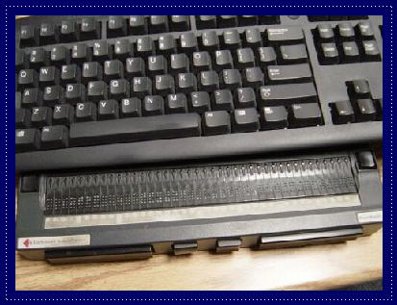

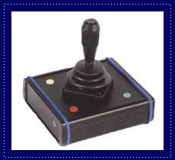
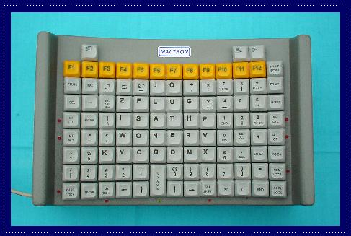
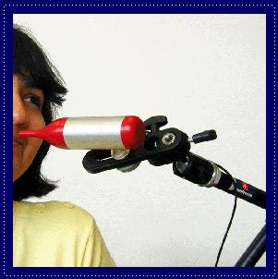
Input Devices

Slide 26
Understandable
Economical and plain use of language
Text supplemented with illustrations, videos, and other formats where appropriate (i.e., use good Universal Design)
Navigation, information structure are discernable and consistent
Make pages operate in predictable ways
Help users avoid and correct mistakes
Notes:
Chunking appropriately, avoiding jargon or institutional language, avoid URL descriptors
Different learning modalities, visual versus verbal
Don’t change nav and layout structure
Careful with AJAX-y elements, pop-ups
Considerate form validation and error correction

Slide 27
Robust
Is your site functional across various technologies (smart phone, screen reader, laptop, pensticks, etc..)?
Syntax errors that don’t affect visual presentation may hamper assistive technology and accessibility tools
Adhering to W3C standards ensures future compatibility
Validate your code!!!

Slide 28
Accessibility Review
Accessibility starts with proper HTML tags
Styling can actually make it HARDER for some people to access the information
Get into the early habit of utilizing accessibility tools
“Cool” new style should not be at the cost of accessibility

Slide 29
Advanced Selectors
We have focused on type selectors but it is possible to style more specific elements

Slide 30
CSS DOM Selectors
Descendant selector
nav li {
list-style-type: none;
}
Child selector
nav > a {
list-style-type: none;
}

Slide 31
id Selectors
#mainLogo {
border: 5px solid #0006CC; }
Identifies a single element in the DOM.
Historically used for <div id = “header”>, <div id=“footer”>, etc.
There is a small movement to move the use of id out of CSS

Slide 32
class Selector
.thumb {
border: 1px solid #0006CC;
width: 200px;}
Identifies element(s) in the DOM that are part of a common group.
Think of thumbnail images, all of the links that are in the navigation, your social media images, etc….

Slide 33
classes vs. ids
Syntax is “.” and “#”
classes can be used multiple times
id should be unique
ids take precedence over classes in styling (see more later)

Slide 34
Changing the Scope
p.main → paragraphs using main class
header img.thumbail → paragraphs inside header that have class=“thumbnail” attribute.
p, h1, #history, .special, → rules to apply to all of them

Slide 35
Pseudo-Classes
Elements that are dynamically populated or dependent on tree structure
focus, hover, first-of-type, last-child
.a:hover {
border: 2px solid #0006CC;
}

Slide 36
More Attribute Selectors
Universal
* applies styling to every element on the page
Ackk!! Try this!
Attribute Selectors
a[href=‘info.html’]
PseudoClasses
Pseudo Elements

Slide 37
Attribute selectors
You can search for elements that have specials attributes by using operators:
^ : match the beginning exactly
a [href^=‘http://umich’]
$ : match the end exactly
img[src$ = ‘.png’] → apply to .png images
* : wildcard
a [href*=‘umich’]

Slide 38
Types of Pseudo-Classes
Structural:
:nth-child, empty, only-of-type, last-of-type
Link
:link, :visited
User Action
:hover, :active, :focus
Forms (interfaces)
:enabled, :checked, :disabled
https://www.w3schools.com/css/css_pseudo_classes.asp

Slide 39
Pseudo-Elements
These elements aren’t part of the DOM
Can be used to style specific (unique) parts of the page

Slide 40
Types of Pseudo-Elements
Textual
:first-letter, :first-line
Positional/Generated**
:before, :after
Fragments
::selection
**Reference this slide for the JS video homework.

Slide 41
States
Some links are blue, some are purple, etc. Why???
a:link: a normal, unvisited link
a:visited: has been visited
a:hover: activated by mouse (touchscreens….?)
a:focus: activated with the keyboard
a:active: is being clicked

Slide 42
Example
Examples:
AdvancedSelectors.html
AdvancedSelectors2.html

Slide 43
Rule Specificity
Each rule has a weight made up of four digits.
+1 for or each element and pseudo-element
+10 for each attribute, class or pseudo-class
+100 for each id
+1000 if the style attribute is used

Slide 44
Specificity example
li { }
<li style="color:#FFFF00">Pizza</li>
nav ul.intro li{}
#content li { }
https://www.w3schools.com/css/css_specificity.asp

Slide 45
Cascading Review
One element can have many classes and ids associated with it
<li class = “special early dark” id = ”main”/>
Browser “starts at the top” and applies each rule, sometimes overriding earlier rules.

Slide 46
The Good News
You can use style sheets from others to style your code, just by adding class!!
You can override style sheets from others just by rewriting the class, or making your own version of it and linking it last.

Slide 47

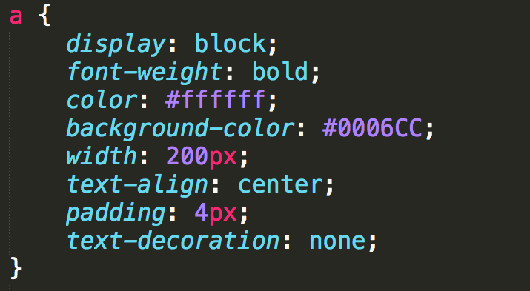

Example: Anchor Links
Links can take on all of the usual styles as well as text-decoration

Slide 48
Example: Lists
Number of properties beyond font, margin, etc.
list-style-type
list-style-image
list-style-position
list-style

Slide 49
List and Link Examples
Examples:
lists.html
links.html

Slide 50
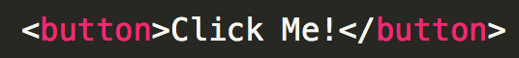
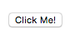
“Buttons”
Many designers try to make their links look like buttons – DON’T!
Be semantic, if you want a button use the <button> element instead.

Slide 51
Acknowledgements
These slides are Copyright 2019- Colleen van and made available under a Creative Commons Attribution 4.0 License. Please maintain this last slide in all copies of the document to comply with the attribution requirements of the license. If you make a change, feel free to add your name and organization to the list of contributors on this page as you republish the materials.
Initial Development: Colleen van Lent , University of Michigan School of Information

